Slide 1
Introductory General Chemistry
Chemistry 3A
Experiment 0a
Lab Exploration
Mitch Halloran

Slide 2
Special Guidance Today
Because you did not have access to your laboratory manuals for this start of lab session, I will quickly guide you to what you need to pay attention to
You will have your manuals today for reference
You have a data report form you fill out today
Use ink pen. NO PENCILS. Just cross-out mistakes
There are 3 parts to Expt 0a
We skip Part 1 – Scavenger Hunt
It has you looking for 20 items; we can learn this later

Slide 3
Part 2: Using A Buret
Equipment/Material Needed
Buret handle carefully. It is an easily breakable analytical device!
Buret clamp | 50 mL beaker
50 mL graduated cylinder | Erlenmeyer flask
Consumables Needed
DI water (~60 mL) | food coloring (2 dyes)
Page 12: mix 1 gtt food dye in ~30 mL DI H₂O in beaker; fill buret; record initial reading on buret; record vol + sketch
p 13: fill grad cylinder ~20-30 mL DI H₂O; record vol + sketch; pour in Erlenmeyer; add different food dye color; mix
from buret, add ~ 5 mL dyed H₂O to Erlenmeyer flask while swirling to mix (DON’T LET FLASK HIT BURET TIP)
Buret stopcock control skill: 1 mL volume + droplet formation

Slide 4
Part 3: Using Pipets, Volumetric Flasks
Equipment/Material Needed
50 mL volumetric flask (2) w/ stopper | 50 mL beaker
scoopula | 10.00 mL volumetric pipet
balance
Consumables Needed
4-6 g NaCl (sodium chloride) | food coloring (2 dyes)
DI water
Page 14: tare balance; weigh empty 50 mL stoppered vol. flask; record to data report
Tare 50 mL beaker; add NaCl; record mass
Add ~10 mL DI water; swirl to dissolve as much as possible; transfer to 50 mL vol flask; add gtt dye; add more H₂O, follow transfer method; fill to flask mark w/ transfer pipet
Take 10.00 mL from flask to new 50 ml flask (use bulb carefully). Fill to flask mark as before using transfer pipet
Compare color of solutions, fill out data report

Slide 5
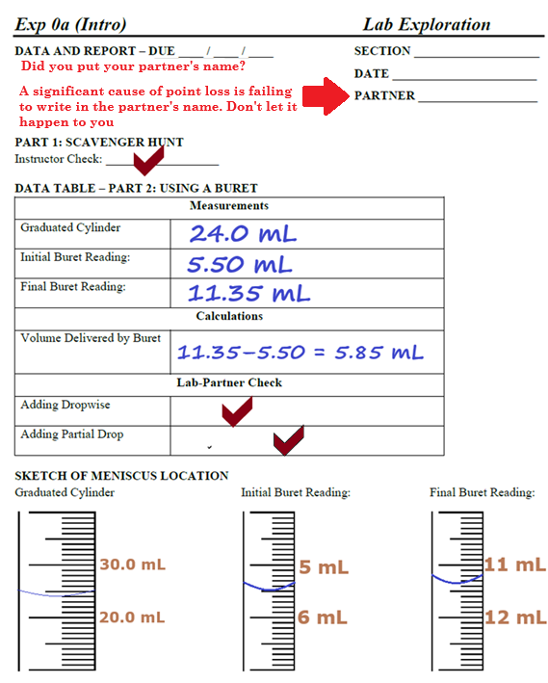
Example Data Analysis

Slide 6
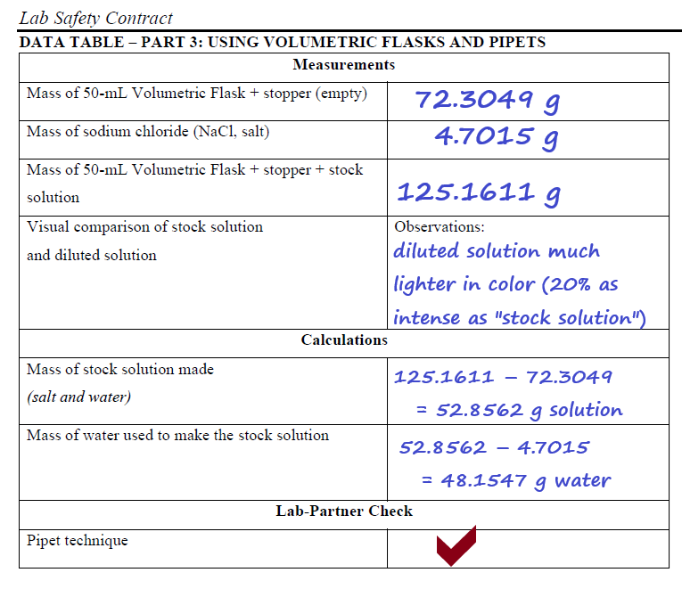
Example Data Analysis

Slide 7
Clean Up
Water and salt solutions can safely be poured down the drain. (Like any household solutions)
  This will not be the case for many solutions which may be strong acids & bases or certain inorganic compounds/salts
Glassware cleaning:
  First with a mild detergent solution: a precaution for organic substances that are lipophilic
  Final rinsing with DI water a couple of times:
    1st rinse with a very small volume
    2nd rinse with a somewhat bigger volume
The best drying of water-rinsed containers and equipment is air drying. You can usually properly place inverted glassware and other equipment on the angled peg drying racks.

